Slide 1
ACT Reading Test
40 questions
35 minutes

Slide 2
CONTENT OF TEST
READING CONTENT PERCENT # OF QUESTIONS
Prose Fiction 25% 10
Humanities 25% 10
Social Studies 25% 10
Natural Sciences 25% 10
Total 100% 40

Slide 3

FOUR CATEGORIES
                Prose Fiction
Passages from short stories or novels

Slide 4


HUMANITIES
Architecture, Art, Dance, Ethics, Film, Language, Literary Criticism, Memoir, Music, Personal Essays, Philosophy, Radio, Television, Theater

Slide 5

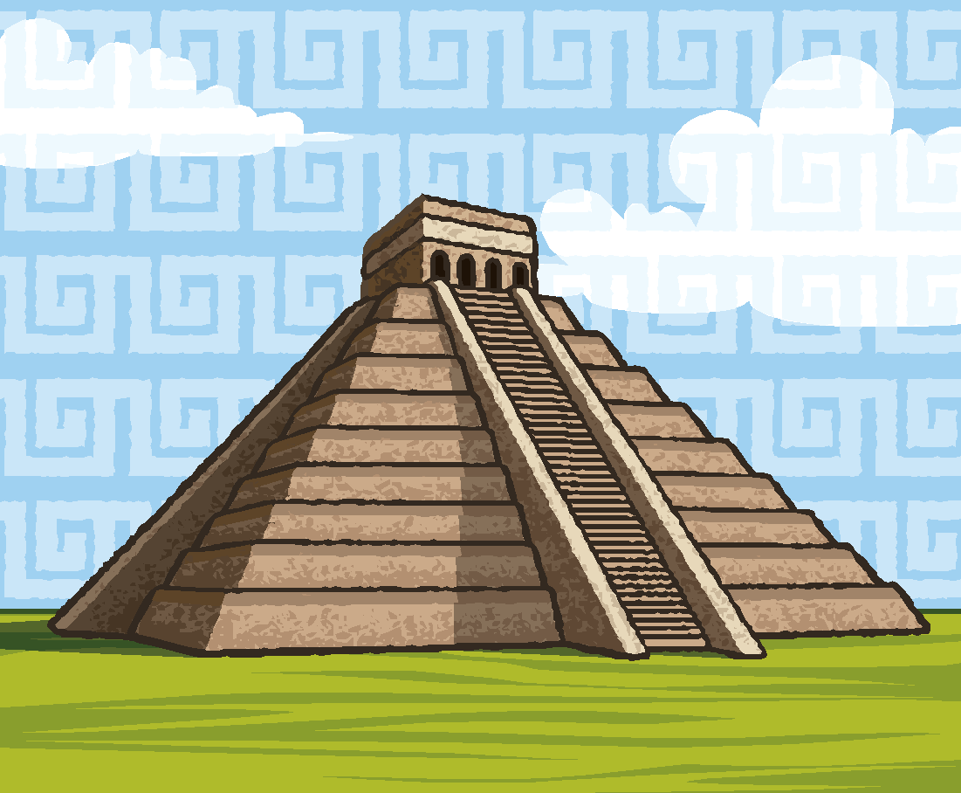
SOCIAL SCIENCES
Anthropology, Archaeology, Biography, Business, Economics, Education, Geography, History, Political Science, Psychology, Sociology

Slide 6

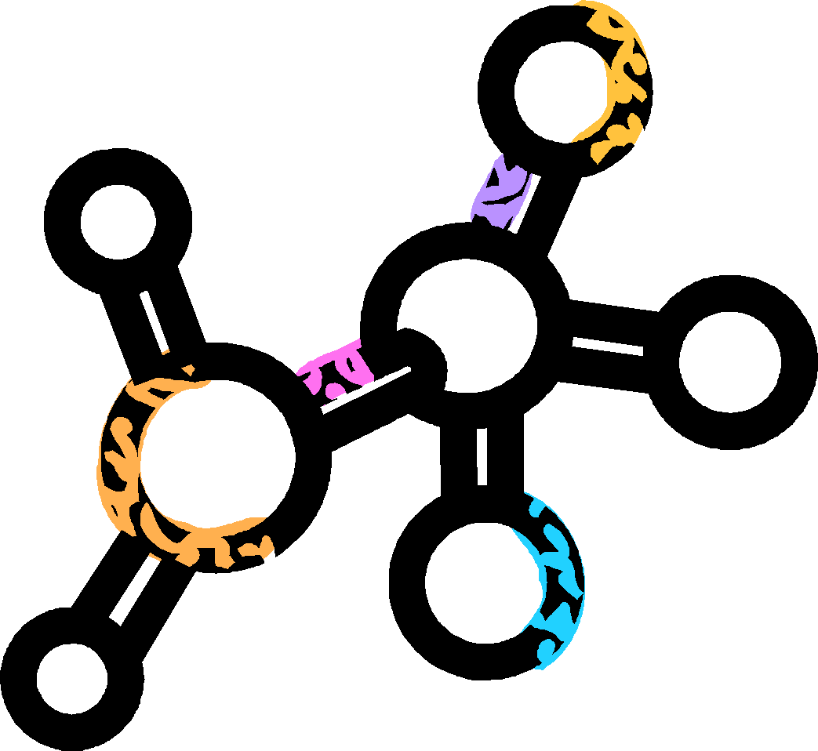

NATURAL SCIENCES
Anatomy, Astronomy, Biology, Botany, Chemistry, Ecology, Geology, Medicine, Meteorology, Microbiology, Natural History, Physiology, Physics, Technology, Zoology

Slide 7
READING TEST SCORE
Social studies/Science Sub score
Arts/Literature
sub score
35 minutes to read the passages and answer 40 multiple choice questions
      About 8 – 8 ½ minutes to read each passage and answer the questions that follow

Slide 8
What am I being tested on?
The reading test evaluates your ability to understand the passages that appear in the test.
It does not test your ability to remember relevant facts from outside the passage.
You don’t need to be knowledgeable about the subject matter, but you do need to read attentively and think carefully about what you read.

Slide 9

PROSE FICTION
Passages generally include:
Narration of events
Revelation of character
Plot, characters, mood
Be aware of mood or tone, relationships of the characters, emotion implied by what characters say and how they say it

Slide 10

HUMANITIES
Humanities passages describe or analyze ideas or works of art. They are written as fact:
present information, pay attention to author and point of view
may have to project the author’s likely response
identify relationships between events, ideas, people, trends or modes of thought

Slide 11

SOCIAL STUDIES
Social Studies passages typically present information gathered by research:
Names, dates, concepts
Cause-effect, comparisons, sequence of
events
Watch the specifics as they relate to the overall idea

Slide 12

NATURAL SCIENCES
Presents a science topic and an explanation of the topic’s significance
Relationships between natural phenomena, not relationships between characters
Cause-effect relationships, comparisons, sequences of events
May include specialized or technical language. The passage will provide
clues to their meaning.

Slide 13

General Types of Questions
Identify and interpret details
Determine the main idea of a paragraph or passage
Understand relationships compare/contrast
Understand cause-effect

Slide 14

Types of Questions cont.
Make generalizations
Determine the meaning of words from context
Understand sequences of
events
Draw conclusions about the author’s voice and method

Slide 15

Strategies
Use the time allotted.
Pace yourself. If you take 2-3 minutes to read each passage you’ll have about 35 seconds to answer each question. Some will take less time which gives more time for the challenging ones.
Think of test as four 8 ½ units and try to complete all the questions for a passage in that time.

Slide 16

Strategies continued
There are short paragraphs with subject headings before each passage. Read these.
They tell you the subject matter, where the passage is from, who wrote it, and a little information about it.
Remember the questions can all be answered based only on the material in the passage. Don’t rely too much on your own background knowledge.

Slide 17

Find your own Strategy
Read each question carefully, so you know what is being asked.
Some people like to answer the easier questions first, then go back to the more difficult ones.
Most experts believe you should answer all questions related to one passage before moving on.
Try to eliminate choices you’re certain are incorrect. Refer back to the passage.

Slide 18

Overall Tips
Look for the best answer, but read and consider all of the options.
Ask yourself whether you can justify your choice as the best answer.
Answer ALL the questions,
you’re not penalized for
guessing.
MARK UP YOUR TEST BOOK!

Slide 19
OMG! I can’t read that fast!
•The vast majority of people can NOT read all of the passages in allotted amount of time so don’t panic.
•Most people find the ?’s on first passage the hardest (inference ?’s on a prose passage)
•Most people find the final passage the easiest (basic ?’s on a science passage)
•But most people do NOT get to the final passage.

Slide 20
Possible Approaches?
•Are you one of the many people who can NOT read that fast?
•Is this general trend of #1 being the most difficult and #4 being the easiest true for you?
•If so, you could START w/ passage 2, go to 3, go to 4, and then finish w/1 (knowing that is the one you may run out of time on)
•Don’t leave any blank and don’t mess up #s

Slide 21

Practice Tests Will See What is best for you

Slide 22

Let’s do a COLD Speed Test and then try it again using a couple of tricks.

Slide 23

THE GOSPEL OF SPEED READING
he text.
ck up the book. Reading at a 45-degree angle is easier on the eyes than off a flat surface.
Never read without a pen. By moving the tip of a pen beneath a line, your eyes will instinctively follow, speeding you up. On a computer, run the onscreen cursor under the text.
Pick up the book. Reading at a 45-degree angle is easier on the eyes than off a flat surface.
Relax your eyes. Focus on full lines, not specific words, using peripheral vision. Move your head, and pay attention to the upper half of letters.
Kill that voice in your head. Silently repeating words slows you down. To break the habit, try quietly humming.
Keep on moving. Resist the urge to "regress" and reread.
Relax your eyes. Focus on full lines, not specific words, using peripheral vision. Move your head, and pay attention to the upper half of letters.
Kill that voice in your head. Silently repeating words slows you down. To break the habit, try quietly humming.
Keep moving. Resist the urge to "regress" and reread.

Slide 24
THE SCIENCE BEHIND SPEEDREADING
You must minimize the number and duration of fixations per line to increase speed
You must eliminate regression and back-skipping to increase speed.
You must use conditioning drills to increase horizontal peripheral vision span and the number of words registered per fixation.
Tim Farriss fourhourworkweek.com/blog/

